Slide 1
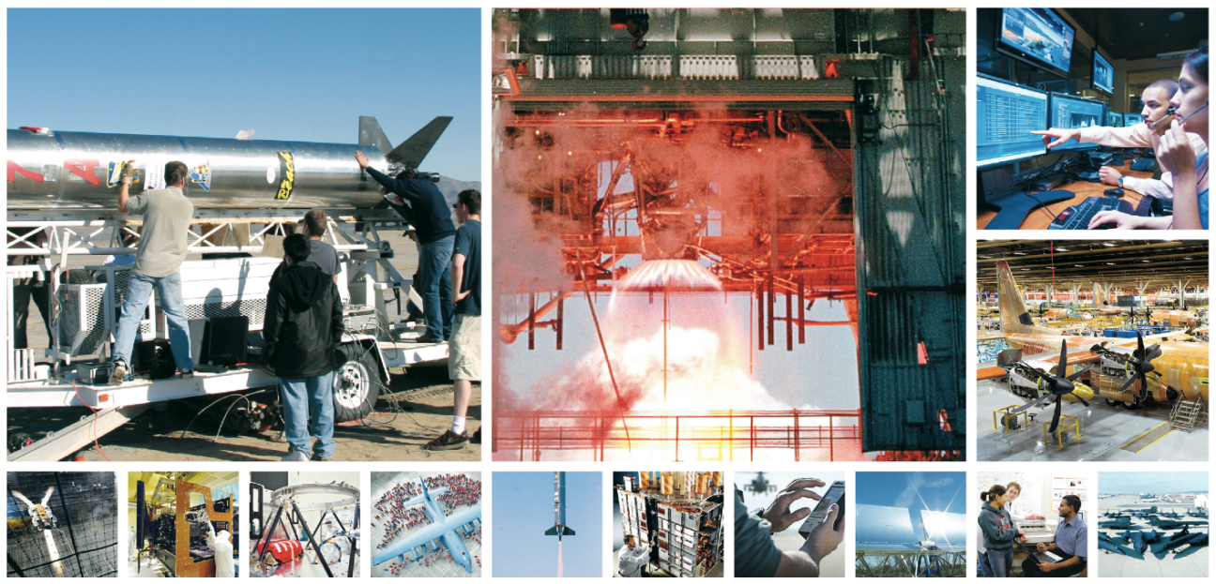

CULTIVATING ENGINEERING TALENT IN THE ANTELOPE VALLEY

Slide 2

Program Uniqueness
Degree Completion for BS Electrical Engineering and BS Mechanical Engineering
Cohort Based
  Opportunity to engage in extensive engineering projects over the course of the program
  Encourages strong teamwork
  Able to emphasize leadership, enhance communication skills, & develop professionalism
Small Program
  Goal is to enroll 25 students in each discipline in the fall (50 students total)
  Providing unprecedented access to industry
  Program is very personal
  Graduation in 2.5 years guaranteed (Students must pass classes and stay in good standing

Slide 3
Program Uniqueness
  Program is highly structured
  Curriculum tailored for our region
  Experienced and highly capable academic and industry faculty
  Very ‘hands-on’ student experiences
Student Preparation
  Occurs at community college or at another university
  Experience indicates students enter program extremely well prepared

Slide 4
Schedule
Sunday | Monday | Tuesday | Wednesday | Thursday | Friday | Saturday
 | 9AM |  | 9AM |  | 9AM
 | 6PM+ |  | 6PM+ |  | 6PM+
Affords opportunity for students to engage with industry as interns during academic year as well as during summers

Slide 5

Accreditation
Western Association of Schools and Colleges (WASC)
Accreditation Board for Engineering and Technology (ABET)
  Both BS Mechanical and Electrical
  Engineering programs accreditation received in
  August
  Identified as BS Mechanical Engineering
  Extension Program and BS Electrical
  Engineering Extension Program on the
  ABET website

Slide 6
Student Success
Due in very large part to outstanding support from our community, education, and industry partners
Graduated two classes
  14 EE, 18 ME, 32 total
  One Magna Cum Laude, three Cum Laude
Cohort 3 to graduate in December
  4 EE, 10 ME, bring total graduates to 46
  One Magna Cum Laude, one Cum Laude
Cohorts 4 & 5 will add 25 ME & 13 EE Graduates

Slide 7
Student Success (Performance)
Graduates enjoy 100% employment rate
97% graduation rate
97% retention rate for program
Graduates compete well nationally
  We have one NSF Graduate Research Fellowship awarded
    Our graduate is conducting research at Stanford University
    The Fellowship will carry graduate through Ph.D.
  Students receive summer internships through Pathways program
    NASA Marshall Space Flight Center - Huntsville, AL
    US Navy Ordnance Disposal Technology Division – Maryland
    NAWCWD (China Lake)

Slide 8
Student Success (Internships)
Internships are paid
Regional Internships
  Northrop Grumman
  AFRL
  NASA Armstrong Flight Research Center
  NAWCWD (China Lake)
  Lockheed Martin (Flight Test)
  AF Test Wing
  BAE Systems
  The Spaceship Company
  Jacobs Engineering
  Crissair
  Pacific Seismic Products
  INCU, LLC
  TYBRIN

Slide 9
Student Success (Performance)
Students and graduates highly regarded by regional industry
  Approximately 80% of students have internships at any given time
  Many interns promoted to employee status while students
  Graduates performing well in industry
    Three graduates at one company reported to have received perfect performance reviews
    One of the three known to have been promoted and named lead engineer for the department less than two years after graduation
    Average starting salary for graduates approximately $70,000/year

Slide 10
In Conclusion
Outstanding unique program design delivered by CSULB College of Engineering
Only one issue to overcome
  Enrollments have not exceeded 60% of that required for self sustaining
  Revenue short fall for existing student base may reach $250,000 by December 2017
    Solutions being pursued to mitigate revenue shortfall
    Marketing expanded beyond Southern California to attract more students

Slide 11

QUESTIONS?
Degree Completion Program in
Mechanical & Electrical Engineering
Offered in the Antelope Valley
http://www.ccpe.csulb.edu/engineering
Notes:
11

